Slide 1
Data Modeling
Amir Dirin

Slide 2
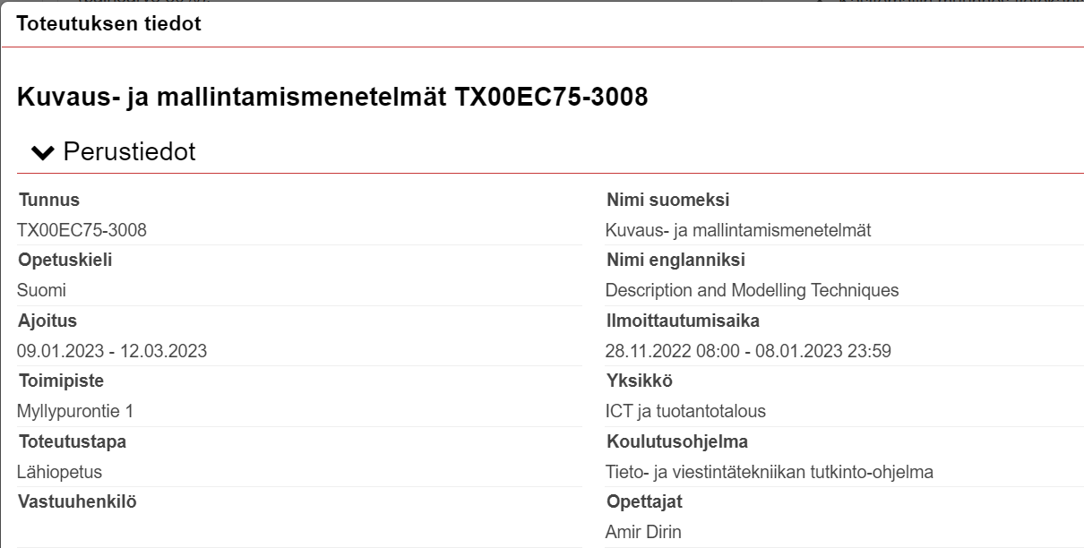

Slide 3
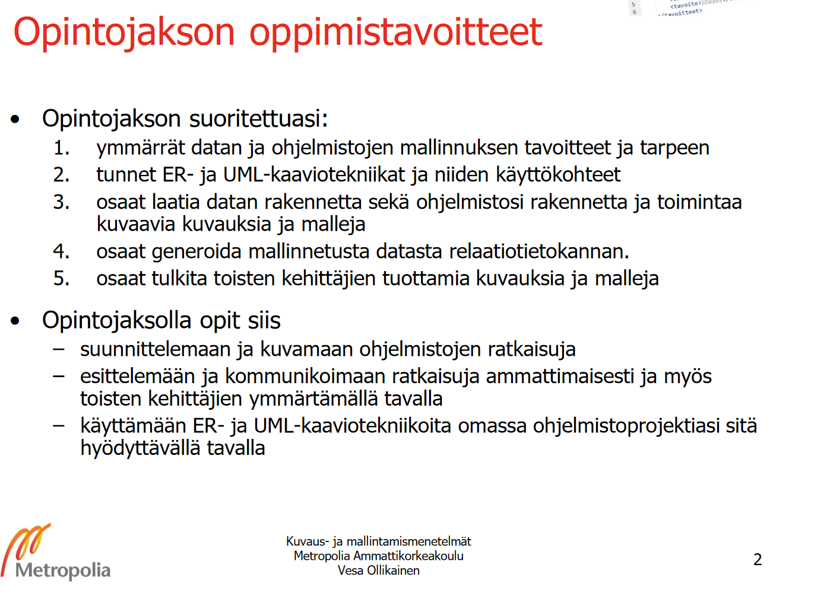
Opintojakson sisältö
rakenteiden mallintaminen ja kuvaaminen
toiminnallisuuden mallintaminen ja kuvaaminen
oliopohjainen mallintaminen ja kuvaaminen (UML)
UML-työvälineohjelmiston käyttö.

Slide 4
Opintojakso kannattaa suorittaa samanaikaisesti Ohjelmistotuotantoprojekti 1 -opintojakson kanssa. Kurssin harjoitteet tukevat OTP-projektin etenemistä.

Slide 5
Arviointiperusteet
Opintojakson arvosana muodostuu harjoituksista (painoarvo 50%) ja kokeesta (painoarvo 50%).
Opiskelijan on saatava vähintään 40% kurssin maksimipistemäärästä. Lisäksi koe on suoritettava hyväksytysti (vähintään 40% kokeen maksimipisteistä).
Kukin harjoitus arvioidaan asteikolla 0..3 pistettä, ja arvioinnin perustana on ratkaisun vaatimusten- ja tavoitteidenmukaisuus. Harjoitus on palautettava Omassa olevaan määräaikaan mennessä, minkä jälkeen alkavalla tunnilla ratkaisu puretaan. Myöhässä palautetusta ratkaisusta voi saada korkeintaan puolet pisteistä. Tehtäväratkaisut on palautettava Omaan ladattavina tiedostoina (ei pilvipalvelulinkkeinä).
Osa harjoituksista on tiimitehtäviä. Näiden osalta yksilökohtaisia pisteitä voidaan opintojakson lopussa painottaa jatkuvan näytön sekä itse- ja vertaisarvioinnin perusteella tilanteissa, joissa työpanokset ovat jakautuneet tiimin sisällä epätasaisesti.

Slide 6
opetusviikko (09.01.-06.03.):
Lopputentti: 01.03
Ensimmäinen uusintakoe: 08.03
Toinen uusinta sovitaan myöhemmin
Tietojärjestelmä, ohjelmisto ja data. Datan mallinnus ja käsitemalli. ERDPlus.
Käsitemallin muunnos tietokanta kaavioksi ja SQL-esitykseksi. Aikasidonnainen data.

Slide 7
Today
Why data modeling?
Types of data modeling
What is a database?
What is data?
Why not just Excel?
What is RDBMS?
Visa card in the US.
Database
Entity
Attribute

Slide 8
Why data modeling
Data modeling is an important stage of any software project because, without it, you cannot get a clear idea of what your database should look like and how your application will be built upon it.
High-Quality Applications
Reduce cost and time of application development
Early Detection of data issues and Errors
Faster application performance
Better Documentation

Slide 9
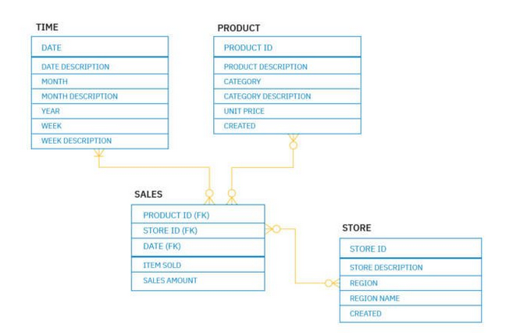
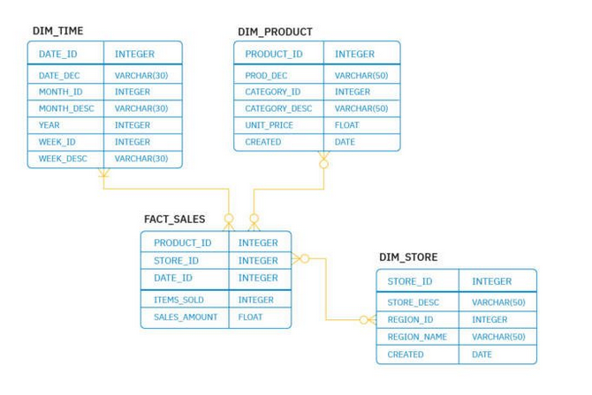
Types of Data modeling
Conceptual (logical) data modeling
Physical Data modeling
Theoritical Data modeling

Slide 10
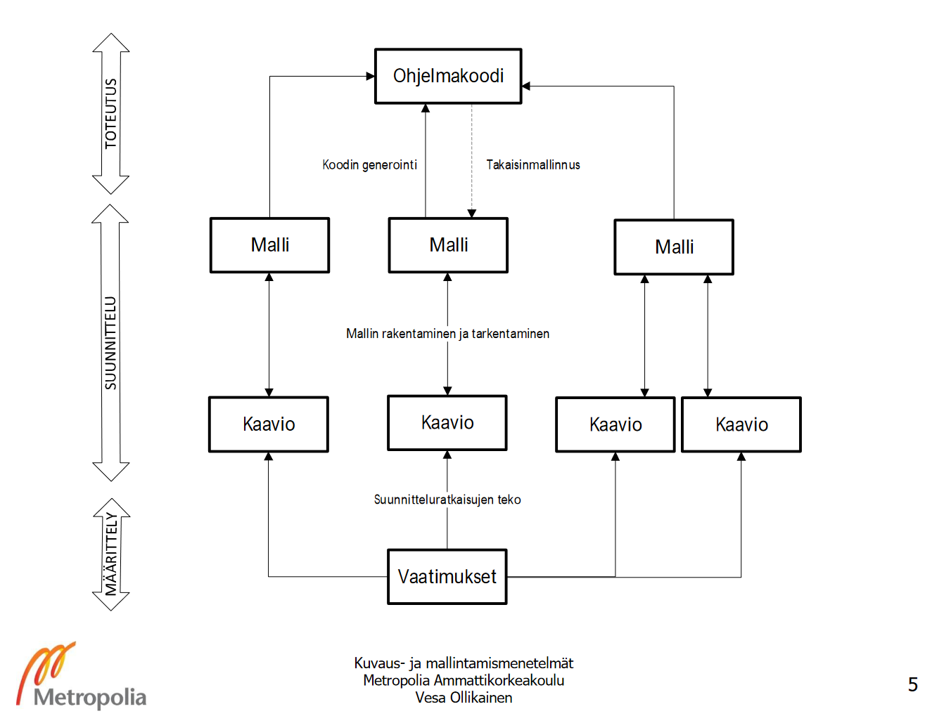
Steps in data modeling
Review the business challenge
Pull the right data from the business
Collect and organize data
Create a conceptual model
Build the logical database design
Build the physical database design
Map stakeholders and their requirements for the data model
Perform a gap analysis of requirements vs. datasets
Deployment & documentation of results
Measure & modify data model to meet changing requirements

Slide 11
Information system (tietojärjestelmä)
90% of the data on the internet has been created since 2016, according to an IBM Marketing Cloud study.
See yourself
https://www.internetworldstats.com/stats.htm
Data are generated all the time
Social Media : 550 new social media each minute meaning 1,209600 new data producing social media each day.
Tweets: 474000 tweets per minute in 2019
Youtube: 400 hours of new video each minute
Instagram: 100 milloin photos and videos every day
Facebook: 510000 comments, 293,000 statuses are updated every minute
3.5 billion google searches each minute
SMS: 100 million messages each minute
Do not agree with me see it yourself
https://www.internetlivestats.com/
https://ourworldindata.org/internet

Slide 12

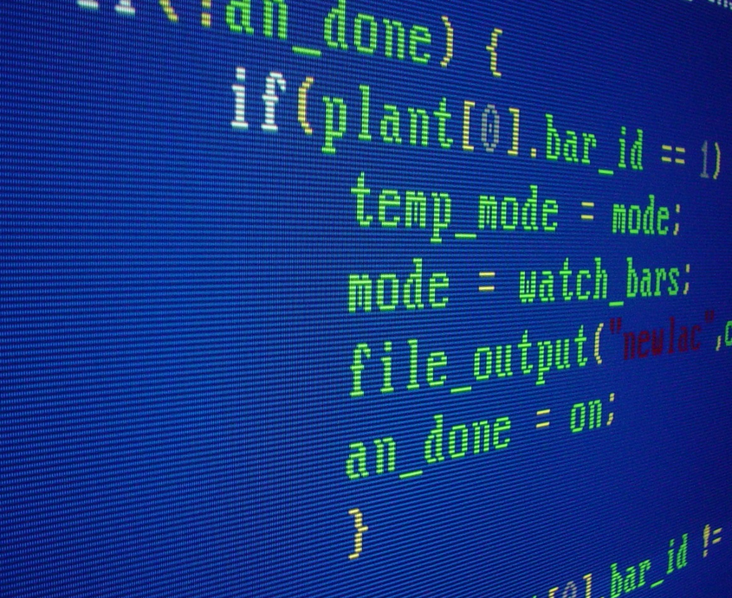
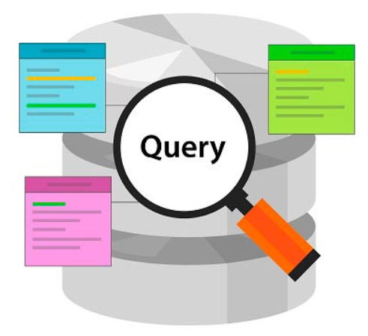
Data is Money
Physical Store
Programing to manipulate date
Retrieve the data / user interface

Slide 13
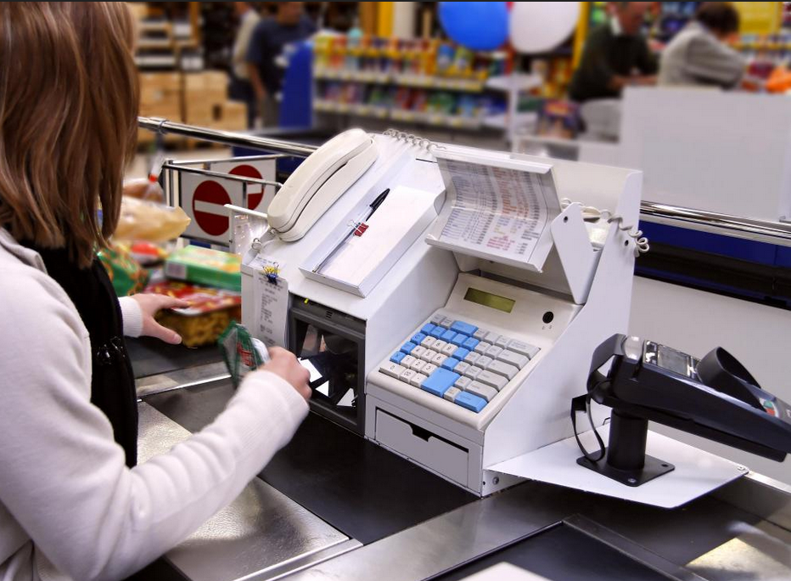
Example

Slide 14
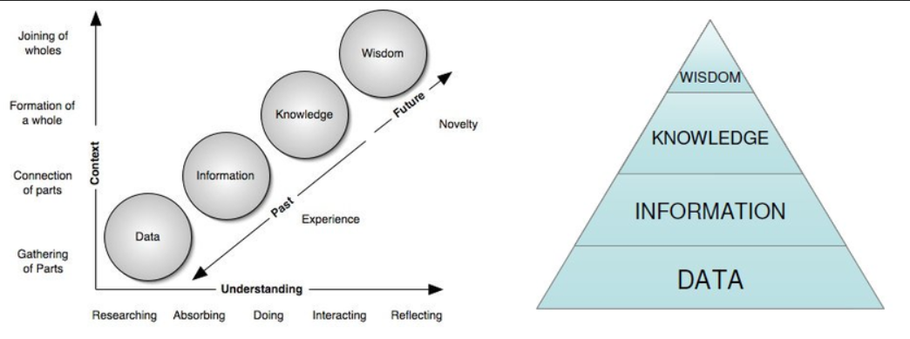
Data
Information
Knowledge

Slide 15
Databases
Spreadsheet
ER database
Big data
What are the differences between these?

Slide 16
Software
Computer Programs and possible documents
Data: data are facts that are used by programs to produce useful information
Procedure: procedure are the policy that governs the operation of a computer system
People mean the end user of every computer-based information system needs people if it is to be useful.

Slide 17
System
System: Set of interrelated components that work together towards a particular goal.
Human body is a system, or what?
Esim: hengitus
Computer!?

Slide 18
ERDPlus

Slide 19
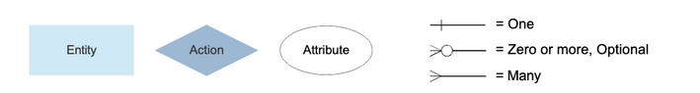
ERD

Slide 20
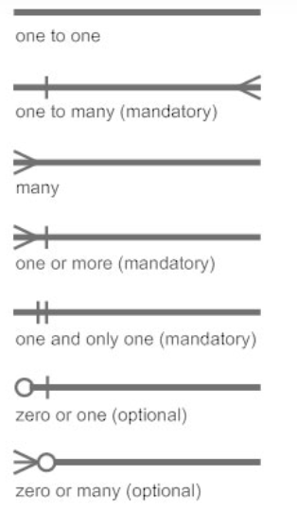
Relations
one-to-one
one-to-many
many-to-many

Slide 21
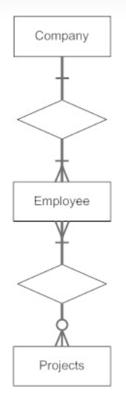
exercise

Slide 22
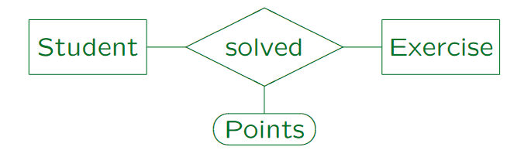
Exampe

Slide 23
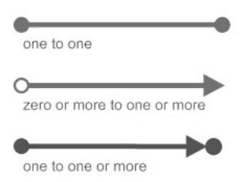
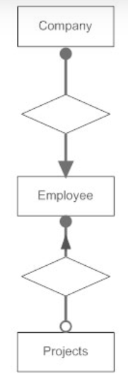
Bachman Style

Slide 24
Example

Slide 25
Exercise
1. Each department has a unique name, a unique number, and a particular employee who manages the department. We keep track of the start date when that employee began managing the department. A department may have several locations.

Slide 26
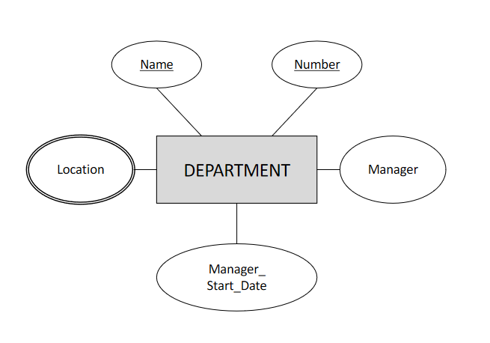
Answer

Slide 27
Exercise 2
A department controls a number of projects, each of which has a unique name, a unique number, and a single location.

Slide 28
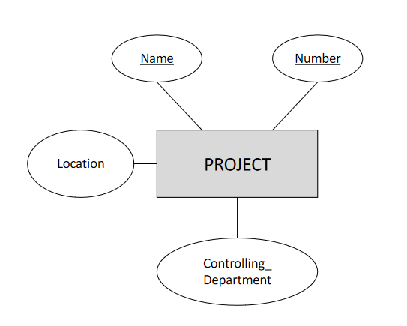
Answer

Slide 29
We store each employee’s name (first, last, MI), Social Security number (SSN), street address, salary, sex (gender), and birth date. An employee is assigned to one department, but may work on several projects, which are not necessarily controlled by the same department. We keep track of the current number of hours per week that an employee works on each project. We also keep track of the direct supervisor of each employee (who is another employee).

Slide 30
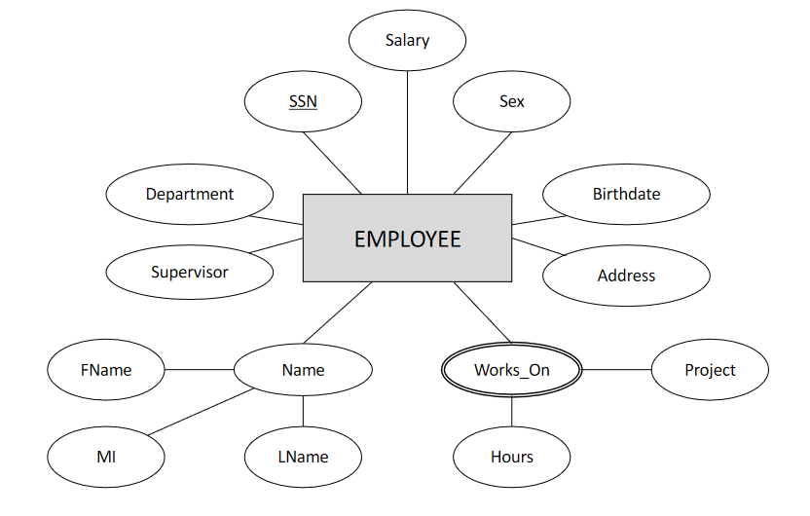

Slide 31
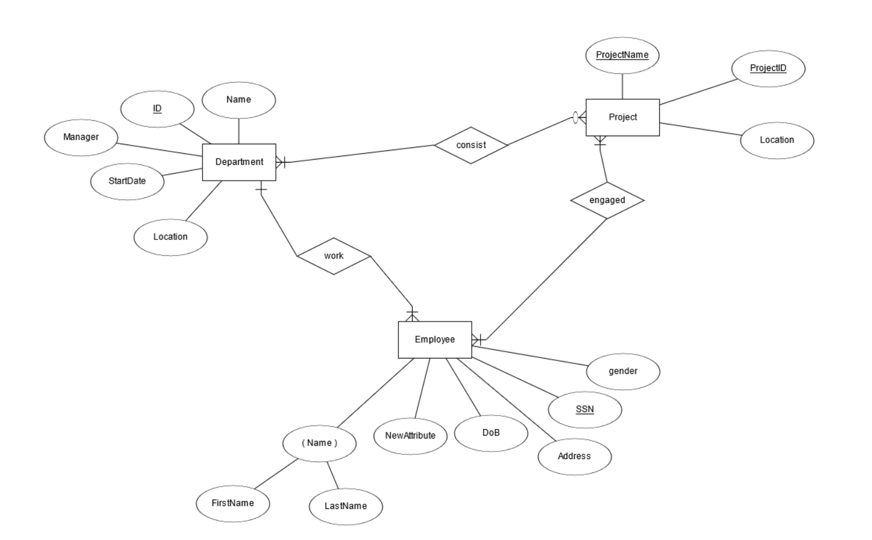
Solution

Slide 32
Assignment (Group)
Define an ER schema (diagram) for the following application: • Information about researchers in the database field must be stored. • For each researcher, his/her last name, first name, email address, and homepage (URL) are needed. • Also his/her current affiliation (employer) is needed (assume that all researchers work at universities). • For each university, its name, URL, and country should be stored

Slide 33
Exercise
Design an ERD with the following scenario
Customers may place an order for one or more products
The following information are associated with customer:
address, name, age, city
Order: order number
Product: Product name, product type, and price

Slide 34
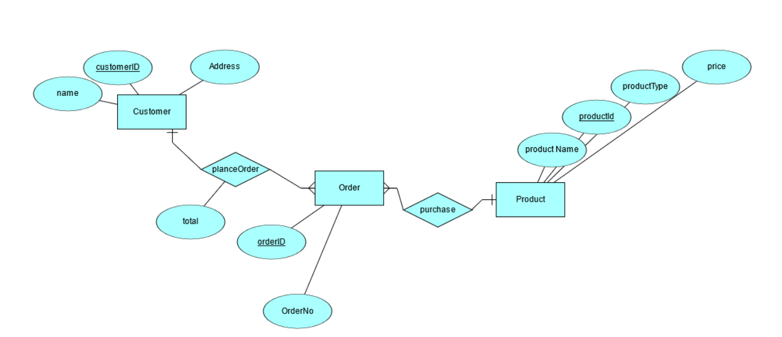

Slide 35
Assignment 2
Courses, Students, Professors  Courses have ids, titles, and credits. The id is unique.  Courses have multiple sections that have time, a room and exactly one teacher  Professors have a unique name  Students take courses and receive a grade  Students may repeat a course  Must track students’ course schedules and transcripts including grades, semester taken, etc.  Must track which classes a professor has taught  The database should work over multiple semesters

